Slide 1




Group1- Infrastructure Automation
Topic - Single Click Geo-Location Based Latest News display
Team Members
Vishal Gupta
Vikrant Vaze
Miloni Kapadia
Rohit Kapadi
Omer Yousafzai

Slide 2
Table of content
Introduction
Network Diagram
Services from Amazon Web Services
Terraform Script (Infrastructure Provisioning)
Ansible Script (Infrastructure Management)
Flow of User request
Budget
IAM Roles
Demo
Future Scope
Thank You & Q/A

Slide 3
Introduction
In this project, we have combined Terraform and Ansible to form an environment on Amazon Web service to display the latest news according to the Geo-location of the user.
Terraform is used to provision the services and enable the communication between the services
Ansible is used to deploy a website and REST API application on the Public and private EC2 instances.
GitHub is used for version control of the scripts

Slide 4
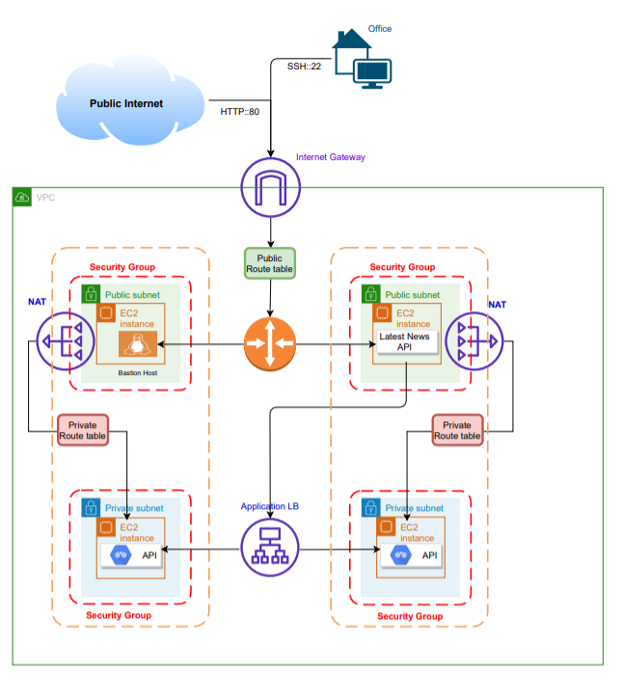
Network Diagram

Slide 5
Service from Amazon web services
Virtual private Cloud – 1
Internet Gateway – 1
Subnets (Public -2 & Private -2 )
Public Route Table
EC2 instances t2 micro – 4
Application Load Balancers
NAT Gateway – 2
Bastion Host
Route Table for Private Subnets

Slide 6
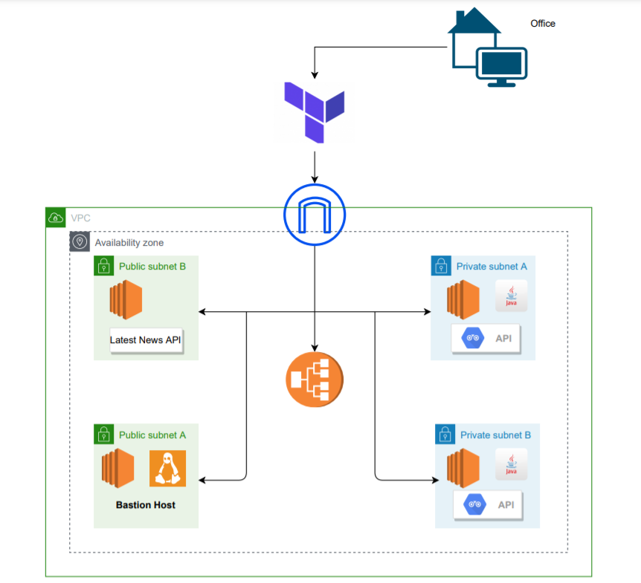
Automation Flow Diagram :

Slide 7




Resource Management
Ansible for Resource Management
A project By Red Hat enterprises
Open-Source Provisioning and Management tool
Very Powerful
High scaling and integration ability
Works well with AWS cloud Architecture

Slide 8
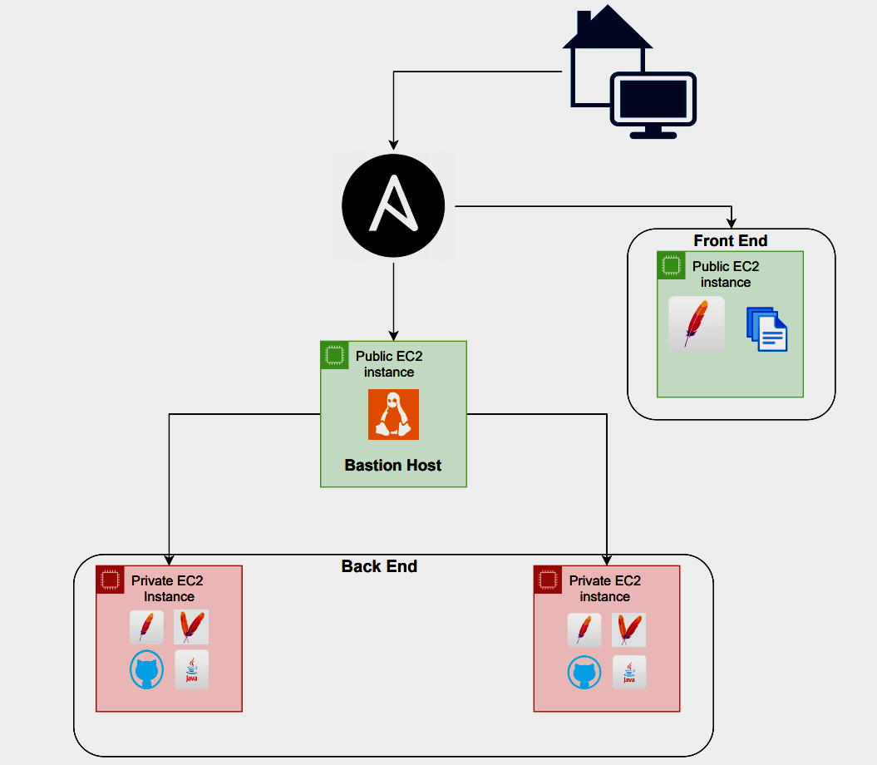
Ansible Managed Network Diagram

Slide 9
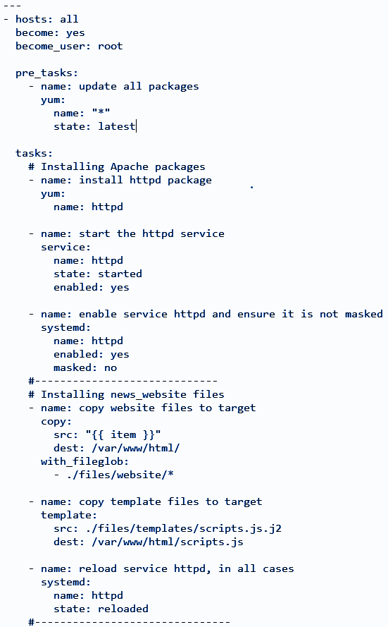
Ansible Script
Front End
Update all packages
Install apache service
Push website files to remote host
Copy template files to remote host
Restart service

Slide 10
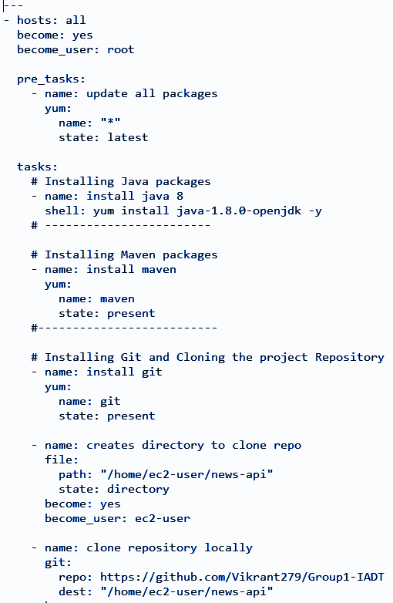
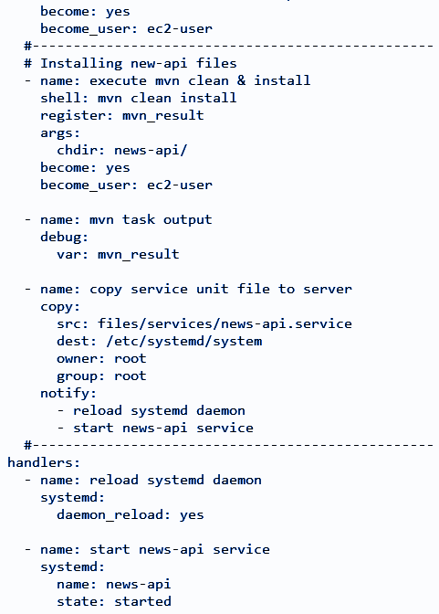
Ansible Script
Back End
Update all packages
Install Java
Install Maven
Install GitHub and Clone Repo
Restart Service

Slide 11
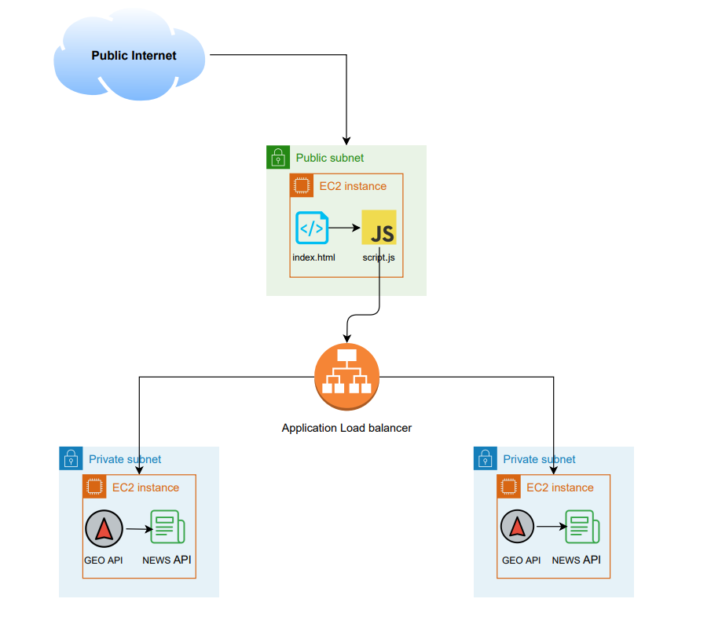
Flow of user request
Capture request on public instance
Redirect traffic to private instance with ALB
Extract geolocation of requestor
Display country specific news

Slide 12
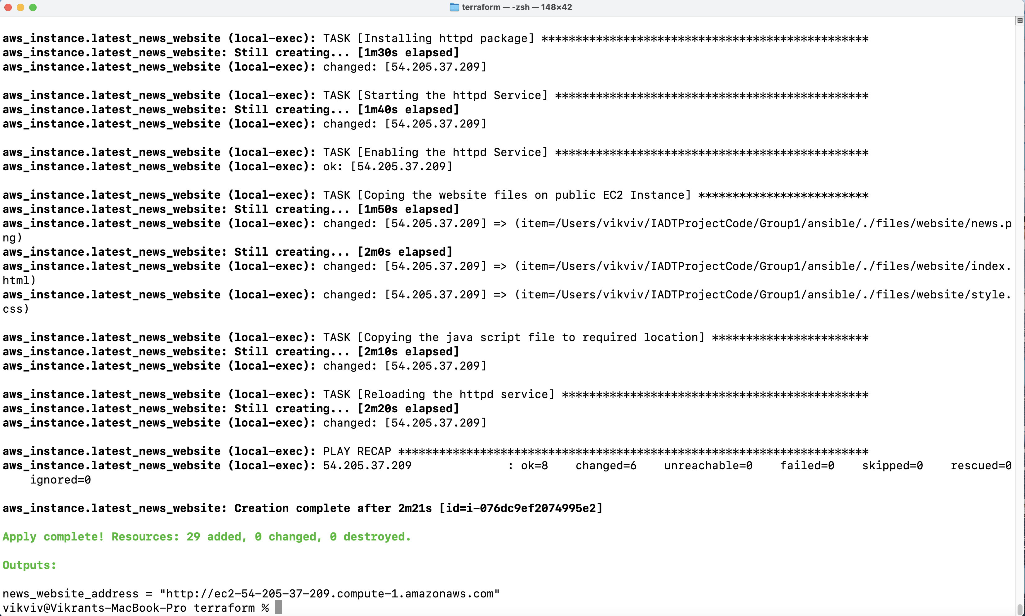
Output Screenshots:

Slide 13

Output Screenshots (USA):

Slide 14
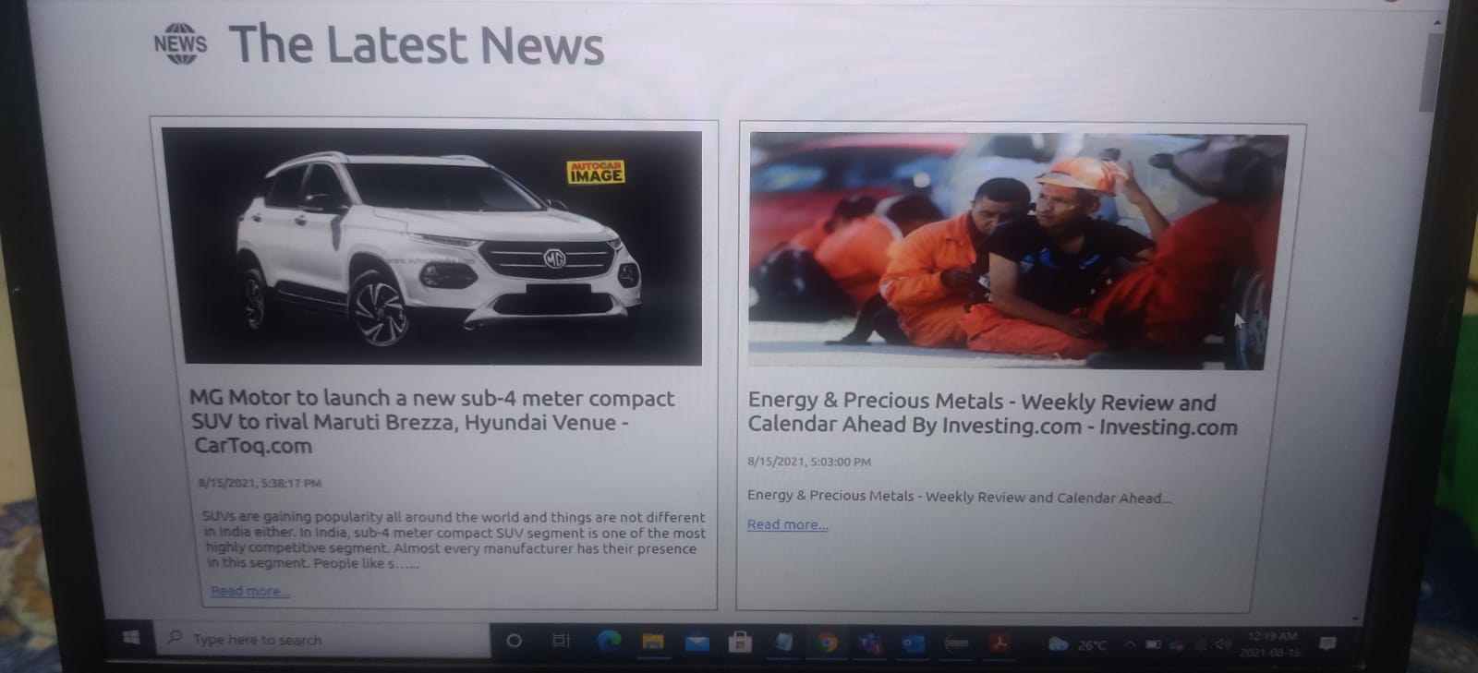
Output Screenshots (India):

Slide 15
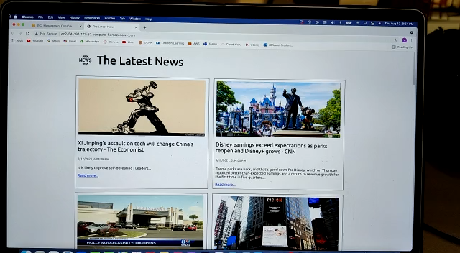
Output Video:

Slide 16
Budget Estimation
(No free Tier Considered)
SR No. | Service Name | Services Used | Cost/Month(USD) | Used | Total(USD)
1 | Instance | t2.micro | 9.5 | 4 | 38
2 | Load balancer | Application | 22.45 | 1 | 22.45
3 | VPC | Nat Gateway | 32.89 | 2 | 65.78
4 | Elastic IP | Elastic IP | 3.65 | 2 | 7.3
5 | Bastion Host SSH | Bastion Host | 8.76 | 1 | 8.76
 |  |  | Grand Total |  | 142.29 USD

Slide 17

IAM Roles
Admin Role : Full access to all of the resources used.
Policy Name: AdministratorAccess
EC2 Instance Access: Provides full Access to EC2 Instance including EC2 Autoscaling and ELB
Policy Name: AmazonEC2FullAccess

Slide 18
FUTURE SCOPE
Add a Domain Name to a Long EC2 Instance DNS name using Route53
Possible Options
Getting an Elastic IP for the Instance
Adding a Load Balancer and attaching the instance with it
Using a service that provides DDNS, for eg. no-ip.com

Slide 19
Thank You
Any Thoughts or Questions

